Slide 1

Project Title- Application where user can create dynamic table to collect all your user data and manage them.

Slide 2
Tech stack used-
-HTML
-CSS
-JAVASCRIPT
-BOOTSTRAP
-MONGODB
-HEROUKO

Slide 3

TEAM-
-Ravella Abhinav
-Penugonda Akash

Slide 4
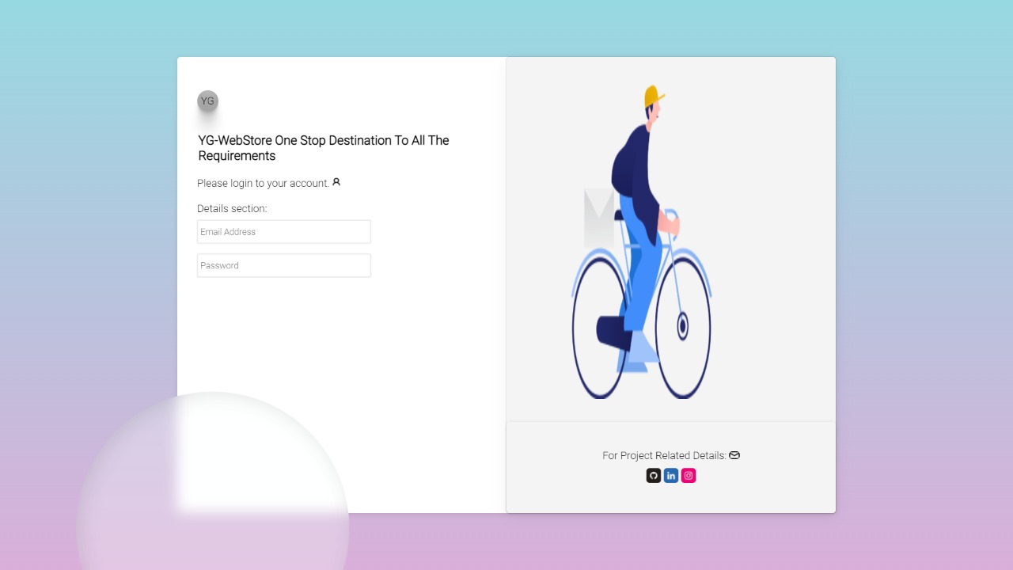
Balsamiq Design

Slide 5
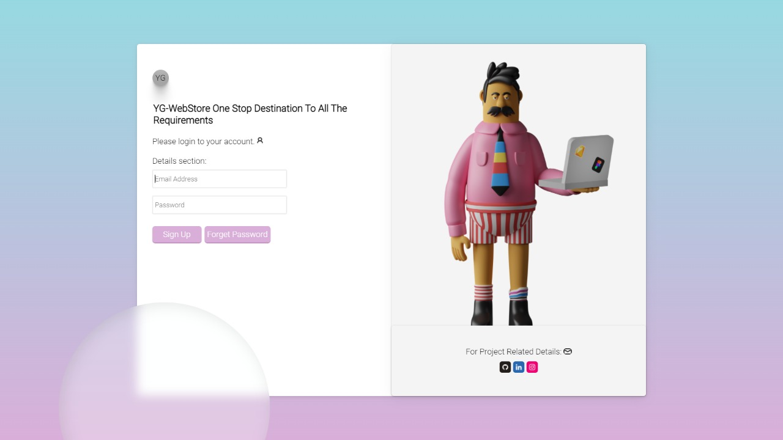

Slide 6
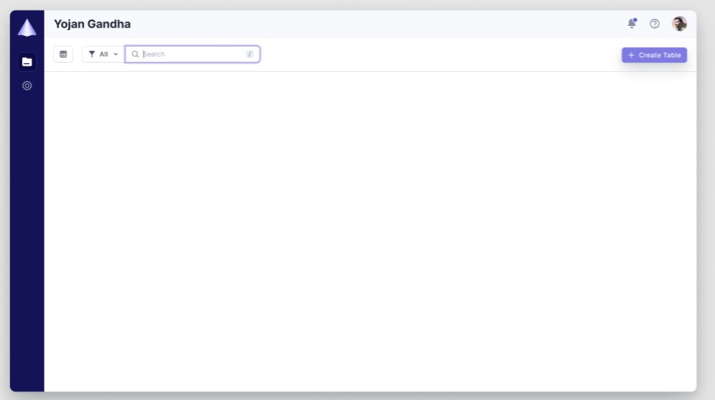

Slide 7
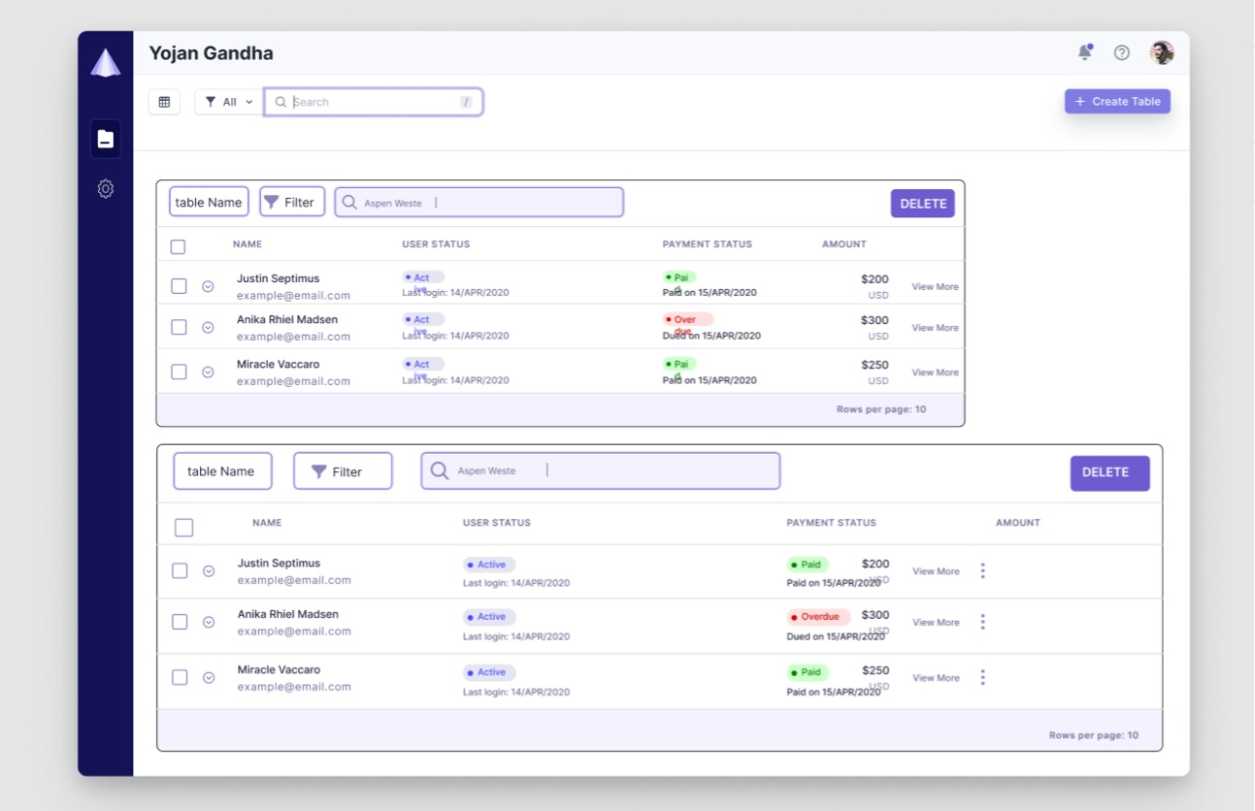

Slide 8

https://github.com/ravellaabhinav/Walkover-Final-Project

